Slide 1



ACROSS CULTURES 4:
Education in Great Britain and the USA
Part 2

Slide 2
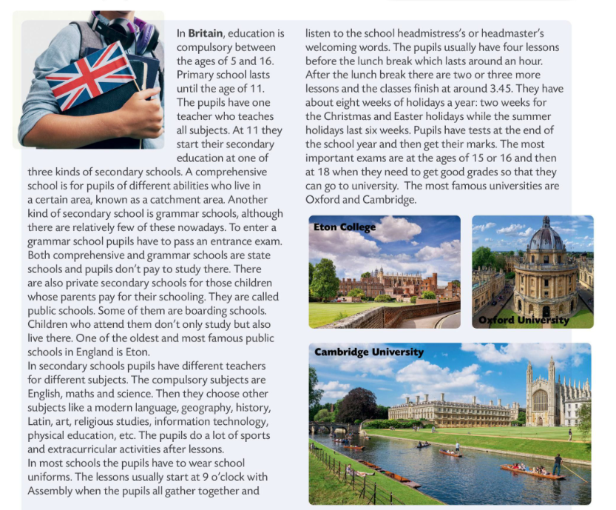





Slide 3
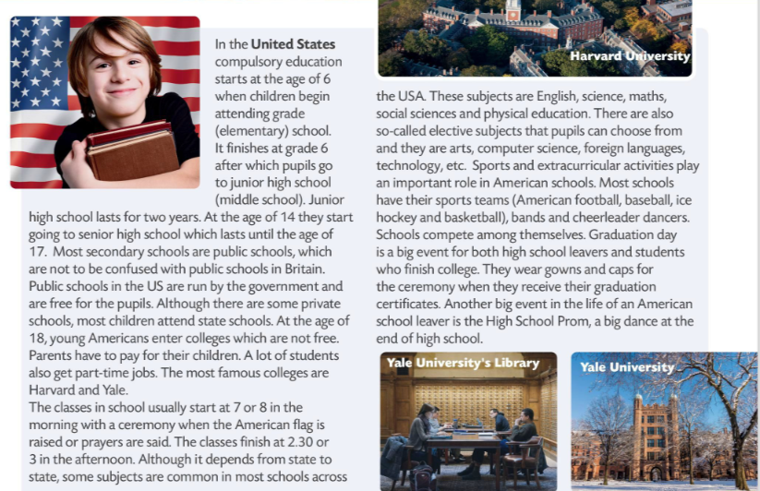

Slide 4
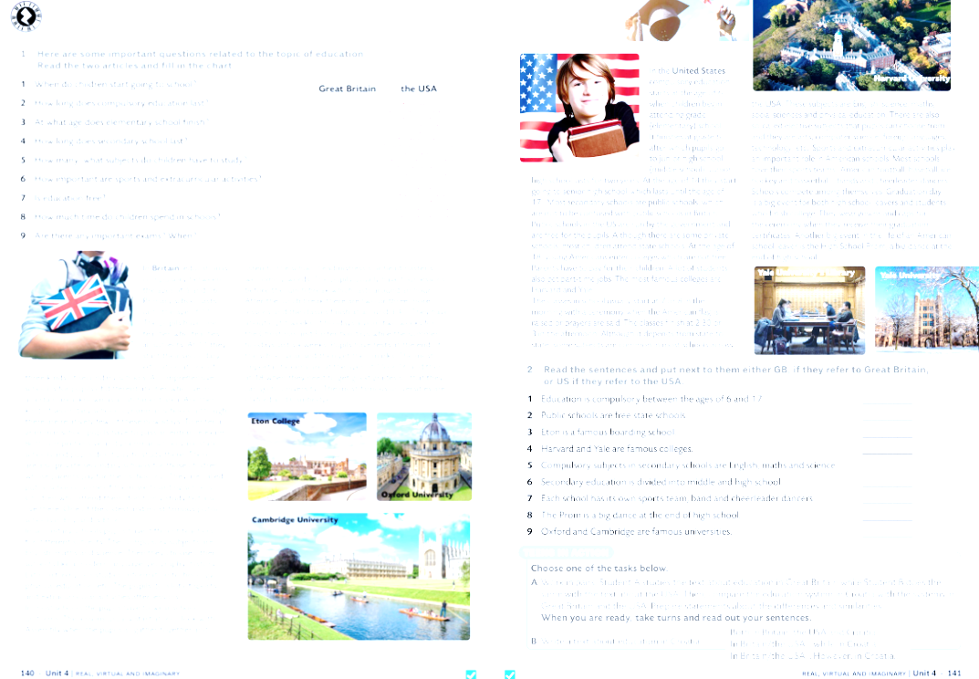
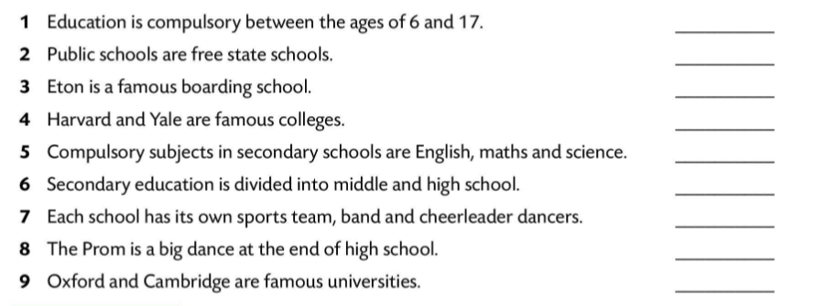
US
US
GB
US
GB
US
US
US
GB

Slide 5
